Slide 1
Simple fractal
Mike Babb
babbm@uw.edu
February 15, 2022

Slide 2
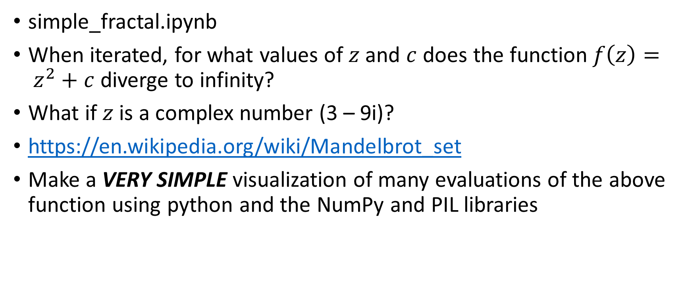
Visualize the Mandelbrot set
simple_fractal.ipynb
When iterated, for what values of $z$ and $c$ does the function$f\left(z\right)= z^{2}+c$ diverge to infinity?
What if $z$ is a complex number (3 – 9i)?
https://en.wikipedia.org/wiki/Mandelbrot_set
Make a VERY SIMPLE visualization of many evaluations of the above function using python and the NumPy and PIL libraries

Slide 3
